Slide 1
Investigation of the Ability of Normality Tests to Detect Issues in Downstream Tests
Ella Li
Oklahoma State University
Joint work with Dr. Pratyaydipta Rudra

Slide 2
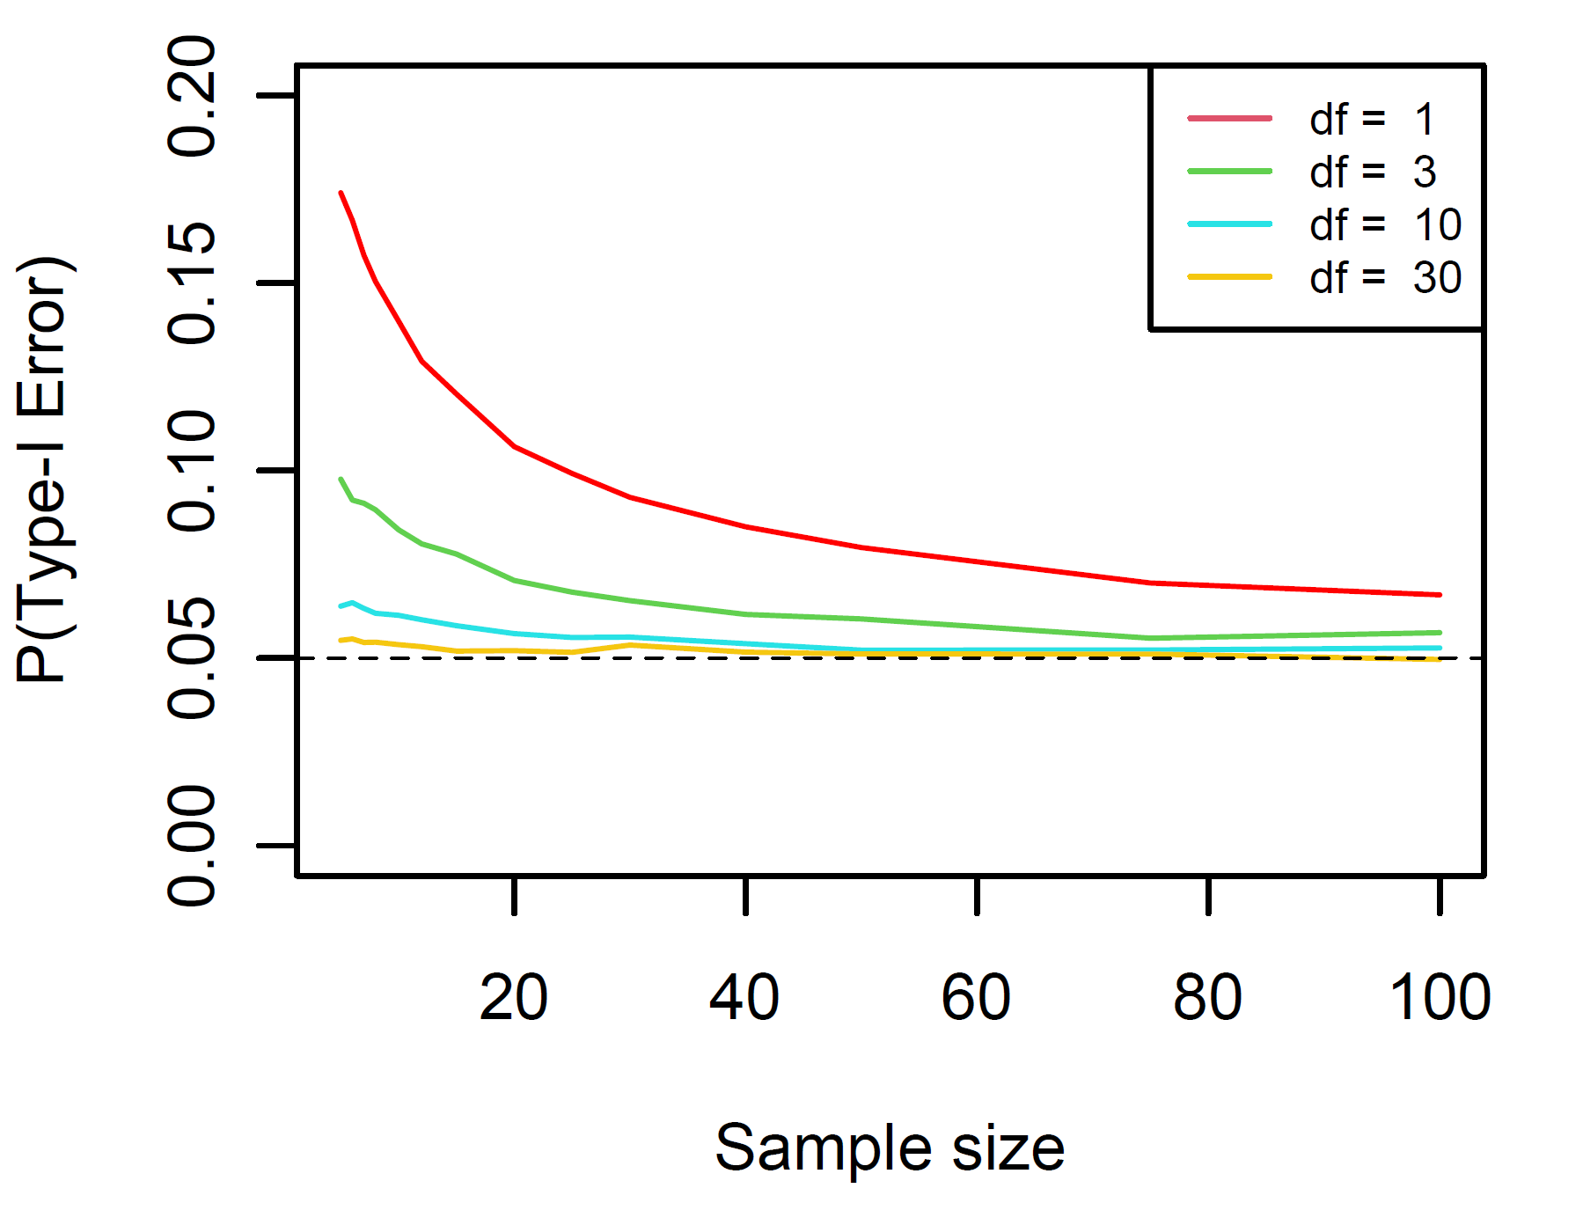

Problems of Violation of Normality
Potentially Inflated type-I error rate
Potential power loss
Example:
Type-I error inflation for one-sample t-test when data comes from $χ^{2}$ distribution

Slide 3
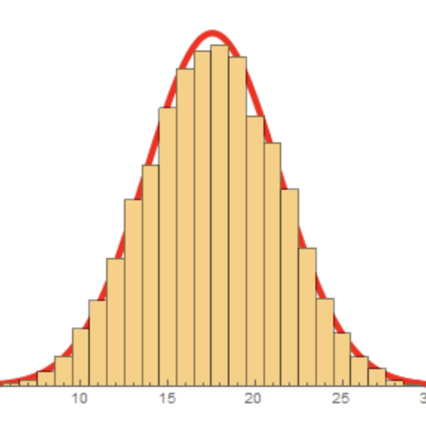
Normality Tests
Shapiro-Wilk Test
D’Agostino-Pearson Test
Kolmogorov-Smirnov Test
Jarque-Bera Test
…

Slide 4
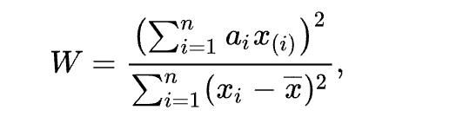
Shapiro-Wilk Test
The Shapiro–Wilk test tests the null hypothesis that a sample x₁, ..., x_{n} came from a normally distributed population

Slide 5
D’Agostino-Pearson Test
a goodness-of-fit measure of departure from normality
Based on transformations of the sample kurtosis and skewness
Calculates how far each of these values differs from the value expected with a normal distribution, and computes a single P value from the sum of the squares of these discrepancies
Has power only against the alternatives that the distribution is skewed and/or kurtic.

Slide 6
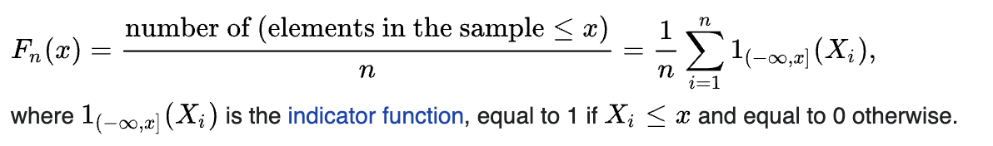
Kolmogorov-Smirnov Test
The KS test can be applied to test whether the data follow any specified distribution, not just the normal distribution
One-sample Kolmogorov–Smirnov test statistic

Slide 7
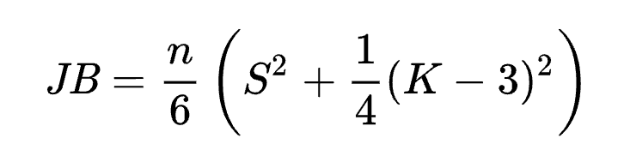
Jarque-Bera Test
The Jarque–Bera test is a goodness-of-fit test of whether sample data have the skewness and kurtosis matching a normal distribution
Where S is the sample skewness,
K is the sample kurtosis

Slide 8
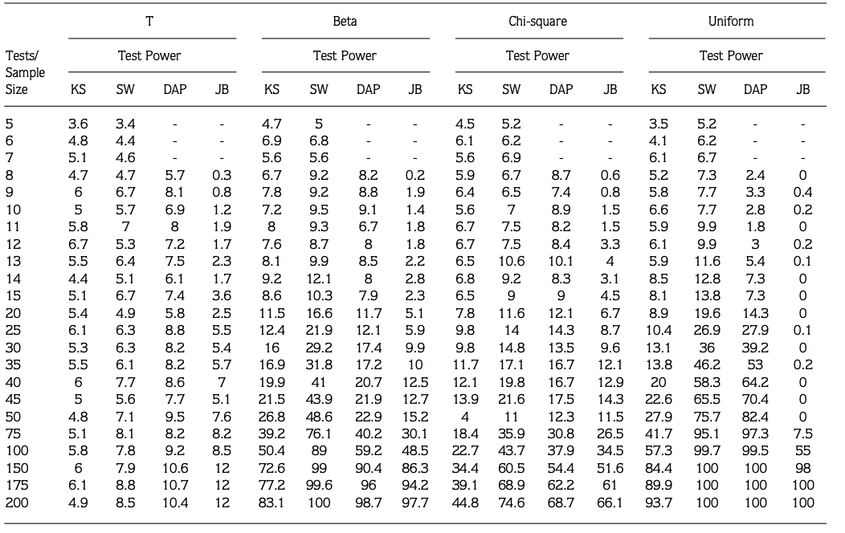
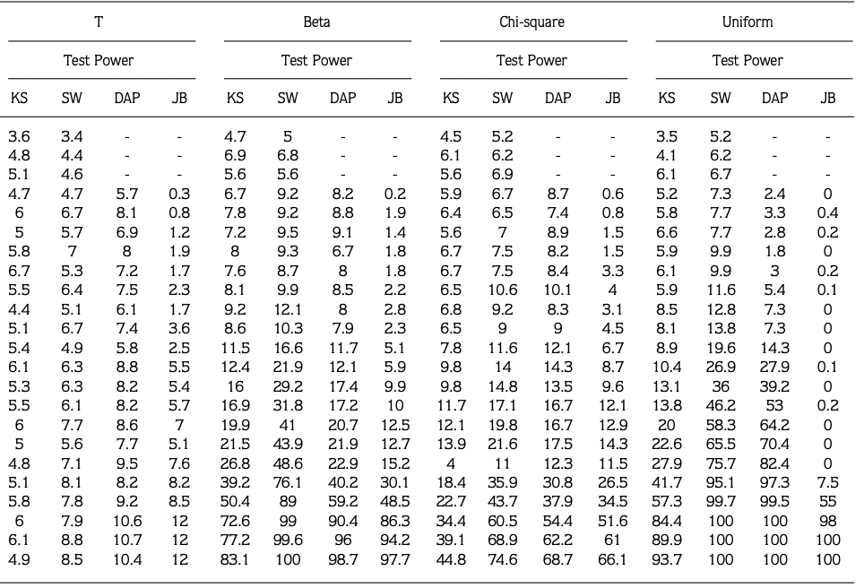
Power of Normality tests for Normal and non-normal distributions
Reference: Öztuna et al. (2006). Investigation of four different normality tests in terms of type 1 error rate and power under different distributions.

Slide 9
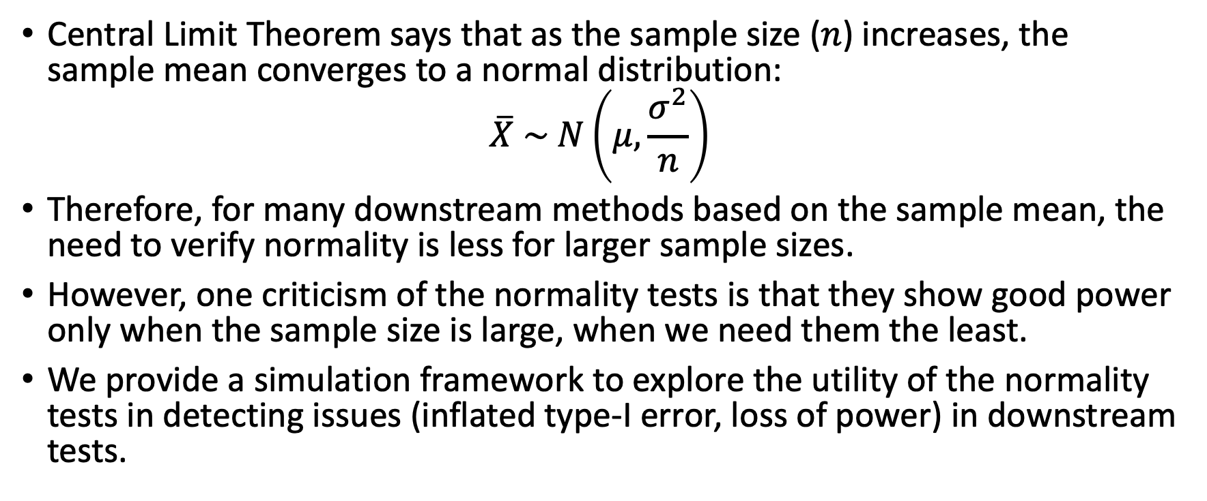

Why Normality tests may not be very useful?
Central Limit Theorem says that as the sample size ($n$) increases, the sample mean converges to a normal distribution:
$$\overline{X} \sim N\left(μ,\frac{σ^{2}}{n}\right)$$
Therefore, for many downstream methods based on the sample mean, the need to verify normality is less for larger sample sizes.
However, one criticism of the normality tests is that they show good power only when the sample size is large, when we need them the least.
We provide a simulation framework to explore the utility of the normality tests in detecting issues (inflated type-I error, loss of power) in downstream tests.
$$a$$

Slide 10
Downstream Tests --- One sample t-test
We conducted simulations (N = 10,000) to generate data from each of the following distributions with varying sample sizes.
Chi-Square Distribution --- Positively Skewed
Beta Distribution --- Chose parameters such that negatively skewed
Uniform Distribution --- Flat tails
We estimated the power of Shapiro-Wilk test and the power and P(Type-I error) for a downstream one-sample t-test.

Slide 11
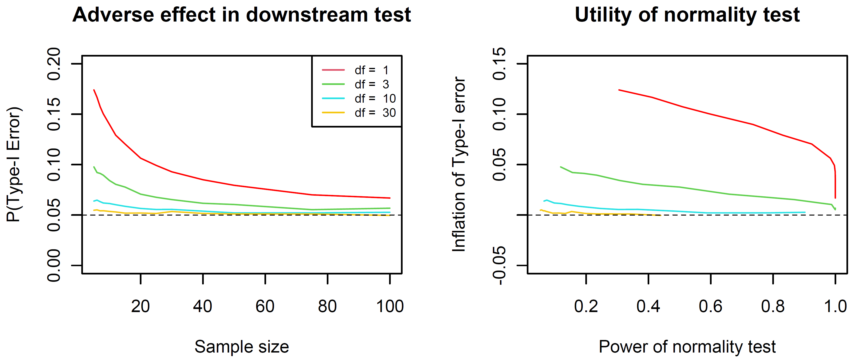
Chi-Square Distribution
Inflated type-I error rate
Less problematic for larger samples
Normality tests somewhat useful for moderate sample sizes

Slide 12
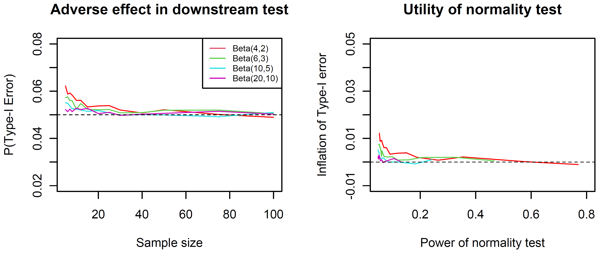
Beta Distribution
Inflated type-I error rate
Less problematic for larger samples
Very little utility of the normality test

Slide 13
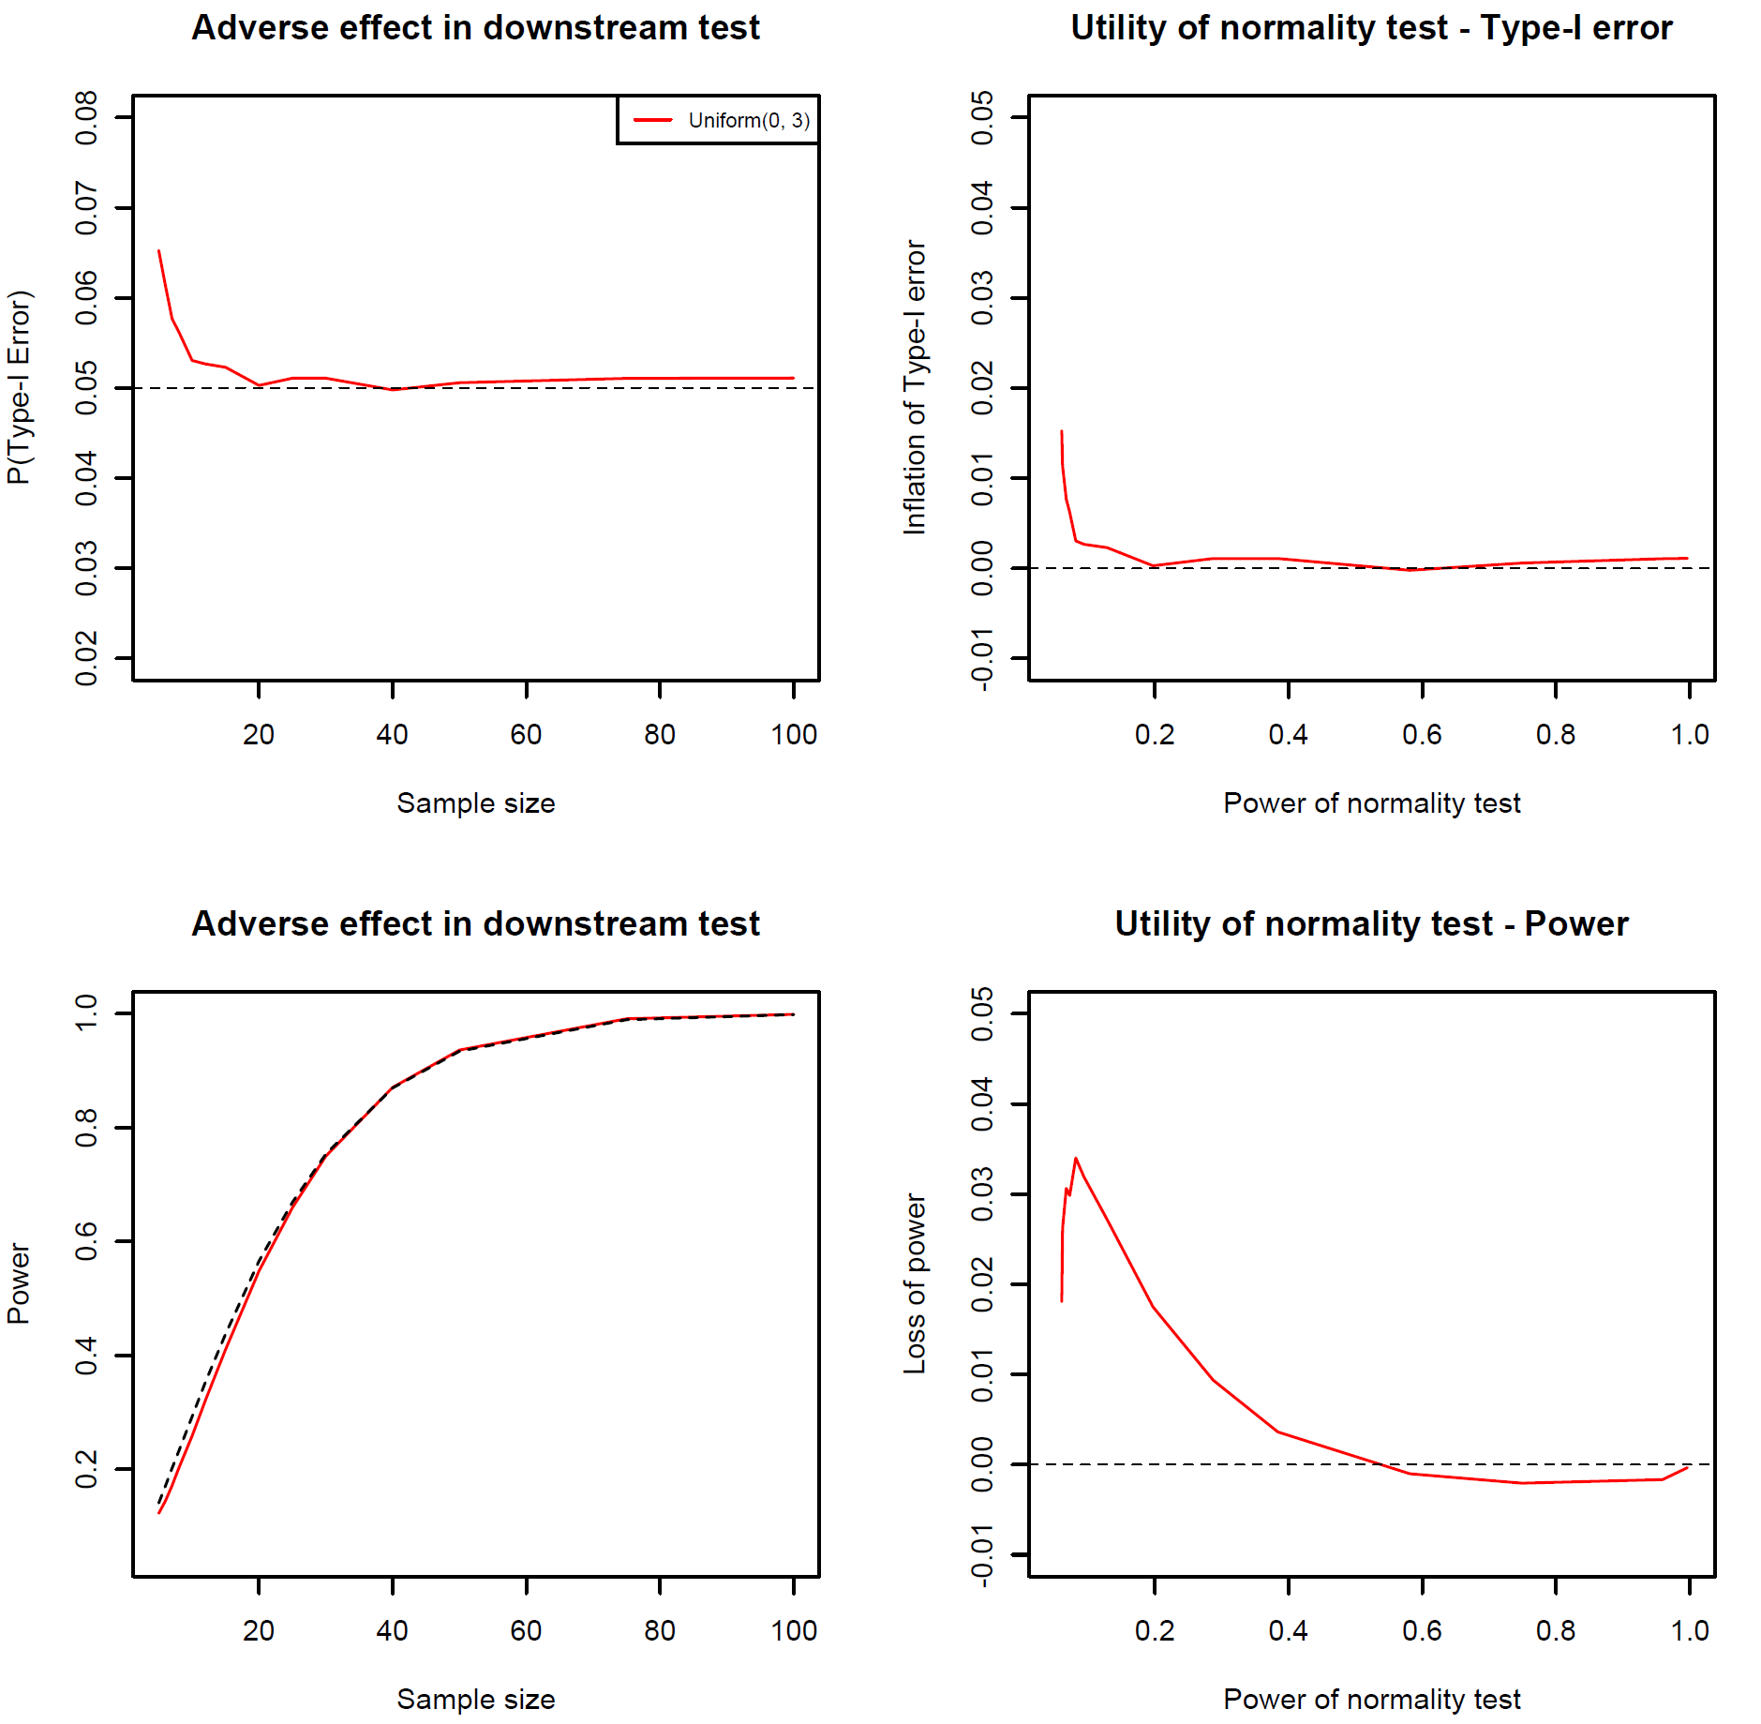
Uniform Distribution
Inflated type-I error rate
Also loss of power
Both are less problematic for larger samples
Very little utility of the normality test

Slide 14
Possible Solutions
Use robust statistical methods that do not use parametric assumptions
Use normality tests that are less problematic

Slide 15
Future Work
Explore other kinds of departure from normality.
Explore other downstream tests.
Explore the performance of other normality tests.
Find what normality tests are less problematic and more useful for a given downstream test.

Slide 16
THANK YOU FOR LISTENING!

